Slide 1
DAO pattern

Slide 2
Background
Have retrieved data from the database
Have built objects from data from the database
Now, we want to organize this
  The DAO pattern
    Data Access Object

Slide 3
Idea
Hide the fact that data is represented differently in the DB
Uniform way of accessing data
  Model layer is now split into two:
    Model layer
      Model classes
    DB layer
      The old container classes

Slide 4
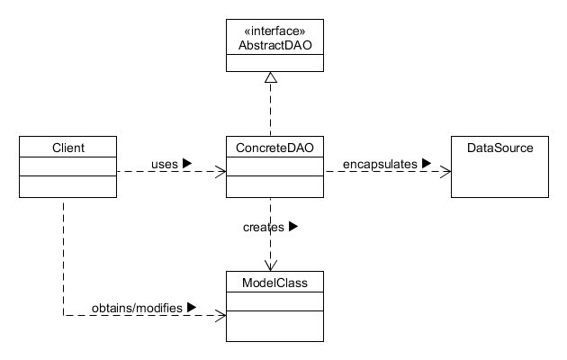
At a Glance

Slide 5
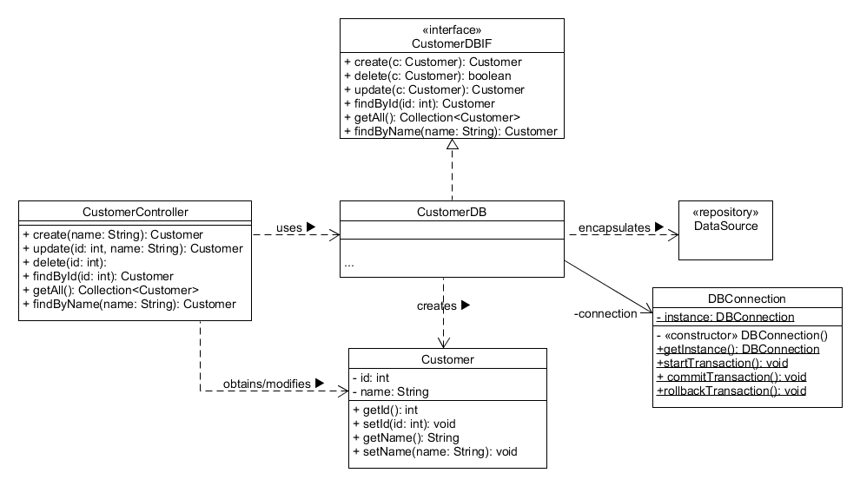
Example (Customer)

Slide 6
Plan:
Be able to print rows from the database
  Embedded SQL exercise 1 (from 2 sessions ago)
Be able to build a model layer object from rows
  Embedded SQL exercise 2 (from 1 session ago)
Study the pattern on the previous slides
Study the FCC project from Canvas
Implement the missing methods
  Create interfaces, classes, and methods as needed
  Make sure you test it all!

Slide 7
Conclusion
We'll conclude with another example
  Company database

